Slide 1
Data Manipulation & Management - Overview
Jeremy Bergmann - Omaha Data Science Academy

Slide 2
What are the course objectives?
Understand the need and purpose behind data manipulation, storage/retrieval, cleaning and management within Data Science projects.
Perform common queries, aggregations, and joins
Combine disparate data sets for analysis
Perform common data extraction, cleaning/transform and loading tasks (ETL)
Understand basic theory behind database design
Evaluate cloud storage platforms and NoSQL alternatives

Slide 3
How is this class structured?
Hour 1: Previous Class Review + Quiz, Topic 1 Lecture
Hour 2: Topic 2 Lecture, Emphasis on Application
Hour 3: Hands-on Exercises & Class Project, Questions

Slide 4
Class 1 Objectives
What is the need for Data Manipulation & Management?
What is SQL? Why learn SQL?
What is a SQL Query?
How do you obtain structured data using SQL clauses?
What is a relational database?
What is a table? How is data structured within a table?
What are the most common SQL data types?
How can you learn more about SQL?

Slide 5
What is the need for data manipulation?
Creating new datasets & Combine disparate data sets
Perform common queries, aggregations, and joins
Adding, removing, or modifying data
Extracting and Storing Data
Creation/Extraction
Transformation data
Manipulating Data
Storage & Retrieval
Notes:
Creation: creating tables and databases, the things
Storage: where data are stored
Cleaning: adding, removing, or modifying data
Retrieval: selecting only the data you want

Slide 6
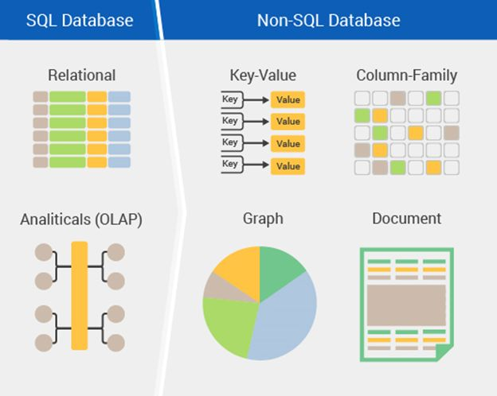
How can you manage large amounts of data?
Storage - Relational or Non-Relational DBs
Relational Database Lingo:
Table - the only data structure in SQL, where data is directly stored
Database - large container filled with tables
Field/Record - column/row
Schema - how a table or database is organized or designed
Notes:
Why Not?
SQL came first by about 40 years, so more businesses use it. Python is harder to learn. SQL is designed to only handle data, so it is fast. Faster than native Python lists or dictionaries. Pandas dataframes are appropriate depending on the context. It’s easier to show and share your work if you document your cleaning process in Jupyter Lab.

Slide 7
What is SQL?
Structured Query Language - Structured Query Language (SQL) is a standard programming language for relational database management and data manipulation
Dialects include MySQL, SQLite, MS SQL Server, Oracle, PostgreSQL, IBM DB2
Query: statement that asks for information from the database
Runs locally, on a server, or in the cloud
Simple and fast - Only one data structure, Optimized
Notes:
SQL Coding Standards

Slide 8
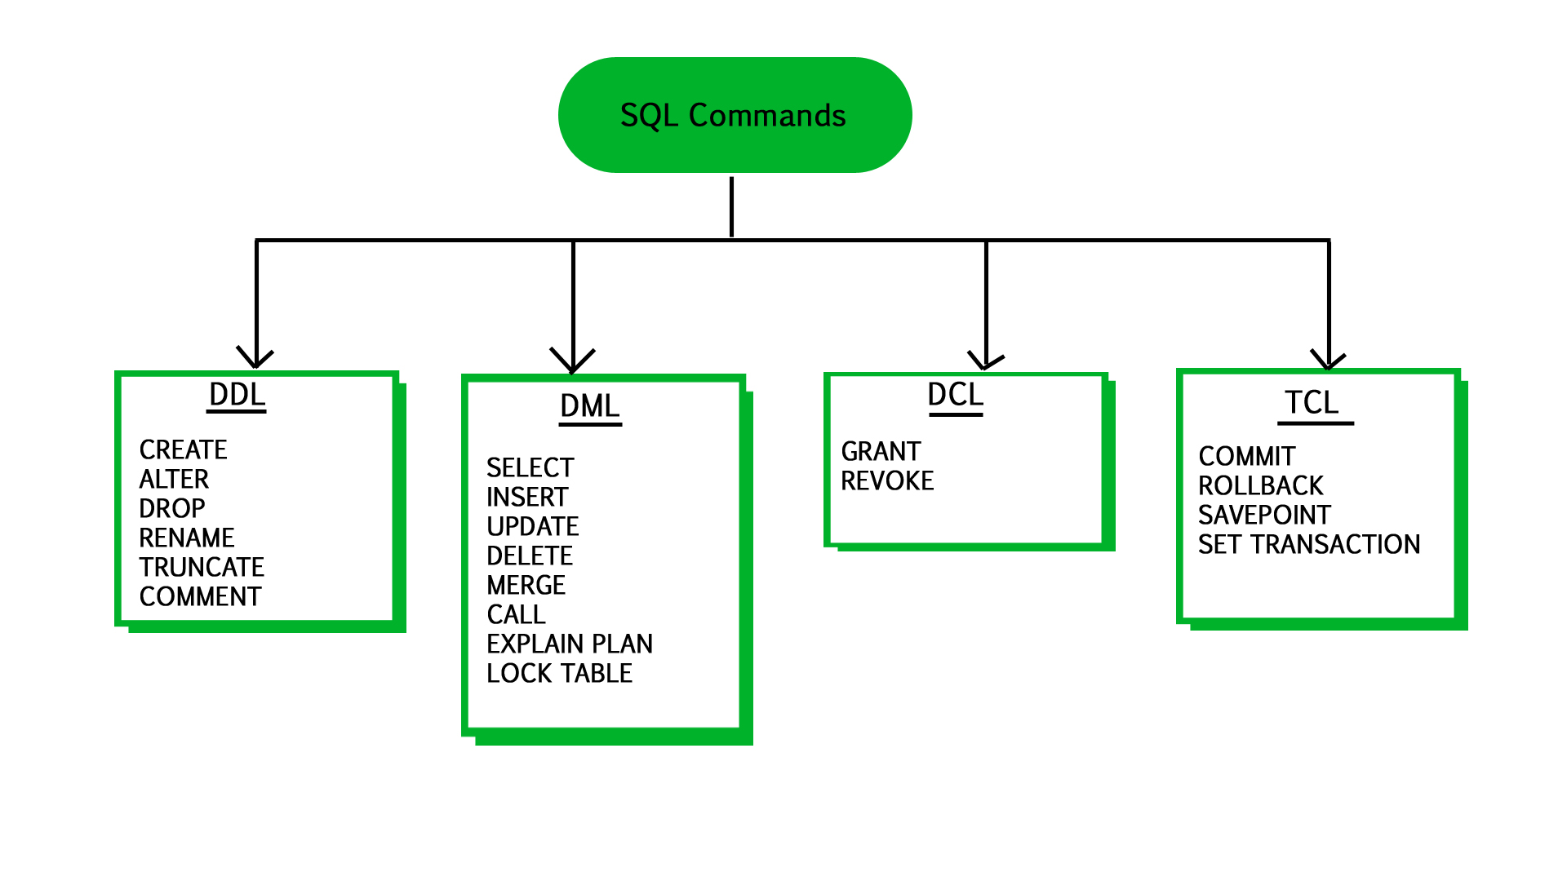
SQL Components
User Access
modifying data structures
Version Control
manipulating data
Notes:
Data Definition Language (DDL) Statements for defining and modifying data structures Ex: DROP, ALTER, RENAME, TRUNCATE
Data Manipulation Language (DML) Statements for manipulating data in tables Ex: SELECT, INSERT, UPDATE, DELETE
Data Control Language (DCL) Statements for managing users’ rights Ex: GRANT, REVOKE
Transaction Control Language (TCL) Statements for saving changes; a limited kind of version control Ex: COMMIT, ROLLBACK

Slide 9
What is a database?
A database is a collection of information that is organized so that it can be easily accessed, managed and updated.
Advantages
Security
Data integrity
Customization
Recovery
Persistence
Data Sharing
Disadvantages
Learning curve
Abstract
Maintenance & Dev costs
Notes:
Security: databases have additional security measures
Data integrity: data changes require intent
Customization: you can organize it best on your needs
Recovery: you don’t lose the data if there’s a catastrophic error
Learning curve: you have to learn how to manipulate it
Abstract: a less visual representation and demands more from the user

Slide 10
What is a table?
Tables: Any display of information in tabular form, with rows and/or columns named
Columns (fields): Set of named values that define the data within in a table.
Rows (records): A single, implicitly structured data item in a table.
CREATE TABLE students (
fname varchar(255),
lname varchar(255),
age int
);
INSERT INTO students (fname, lname, age)
VALUES ('Nathan', 'Booth', 31),
('Fatima', 'Asad', 22),
('Zoe', 'Stoklos', 42);
Notes:
CREATE TABLE students (
fname varchar(255),
lname varchar(255),
age int
);
INSERT INTO students (fname, lname, age)
VALUES ('Nathan', 'Booth', 31),
('Fatima', 'Asad', 22),
('Zoe', 'Stoklos', 42);

Slide 11
Common Data Types
Strings | Numeric | Dates | Other
CHAR | INT | DATE | BLOB
VARCHAR | DECIMAL | DATETIME | BOOLEAN (TINYINT(1))
 | FLOAT | TIMESTAMP
 | DOUBLE
Size matters as scale increases.
Signed values: positive and negative
Unsigned values: positive only
“Big” Data Types: Hold very “large” signed/unsigned values
Precision: number of digits
Scale: number of digits right of decimal point
Fixed-point decimals: represent exact values
Floating-point decimals: represent approximate values
BLOB: binary large object, stores files as binary data

Slide 12
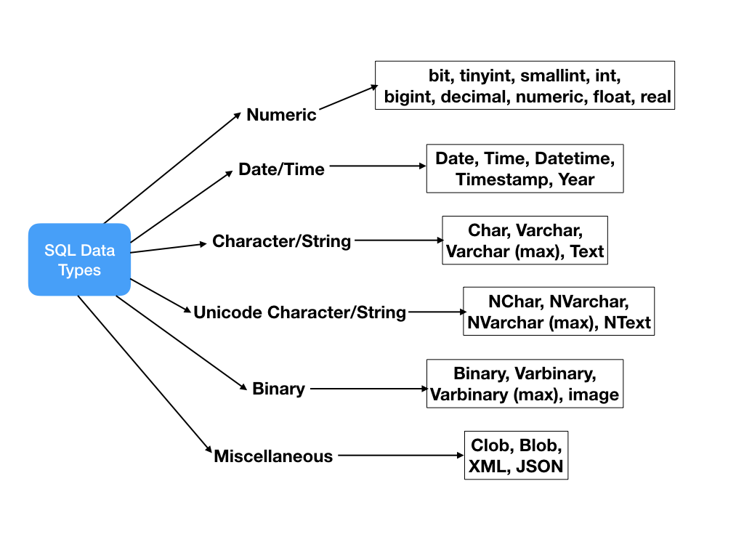
What data types can you use?
Tutorial: https://www.tutorialspoint.com/mysql/mysql-data-types.htm

Slide 13
What is a Query?
MySQL Query Syntax
SELECT [ALL/DISTINCT] column_list
FROM table_list
[WHERE conditional_expression]
[GROUP BY group_by_column_list]
[HAVING group_by_conditional_expression]
[ORDER BY order_by_column_list]
[LIMIT number_of_records]
* Required Clauses
A query is a request to the SQL Database for data, to answer a question.
When we query databases, we use a common language to get information - SQL or Structured Query Language.
Notes:
General Syntax:
SELECT [ALL/DISTINCT] column_list
FROM table_list
[WHERE conditional_expression]
[GROUP BY group_by_column_list]
[HAVING group_by_conditional_expression]
[ORDER BY order_by_column_list]
[LIMIT number_of_records]
Write a summary of the information as if explaining to a 14 year old. Avoid jargon Keep the words and sentences simple Rely on memory Make the explanation visual, if possible Note where you had difficulty or have knowledge gaps. These indicate things you should review, research, or ask questions about

Slide 14
Query – Clause Sequence
Tables
Columns
FROM
SELECT
Results
WHERE
GROUP BY
HAVING
ORDER BY
Criteria
Sort
Notes:
General Syntax:
SELECT [ALL/DISTINCT] column_list
FROM table_list
[WHERE conditional_expression]
[GROUP BY group_by_column_list]
[HAVING group_by_conditional_expression]
[ORDER BY order_by_column_list]
[LIMIT number_of_records]
Write a summary of the information as if explaining to a 14 year old. Avoid jargon Keep the words and sentences simple Rely on memory Make the explanation visual, if possible Note where you had difficulty or have knowledge gaps. These indicate things you should review, research, or ask questions about

Slide 15
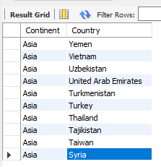
Example - World Query
Obtain a list of countries within the continent of Asia.
SQL Query
SELECT continent, name AS country #what columns to get
FROM world.country #what schema/table to read
WHERE continent = 'asia' #limit results”
ORDER BY continent, country DESC #Sort rows in result”
LIMIT 10 #number of rows to “bring back”
Notes:
Format for readability
FROM: what table to read
SELECT: what columns to get
AS: rename the column
GROUP BY: combine rows by column value
ORDER BY: sort in ascending or descending order
HAVING: Limit final results of aggregate function
LIMIT: constrain the number of rows displayed
SELECT continent, name as country #what columns to get
FROM world.country #what schema/table to read
WHERE continent = ‘asia' #limit results”
ORDER BY continent, country DESC #Sort rows in result”
LIMIT 10 #number of rows to “bring back”

Slide 16
Where can you learn more SQL?
Interactive Tutorials
W3schools
SQLZoo
Mode Analytics
SoloLearn
SQL Tutorial
SQLBolt
Database Performance (advanced)
Static Tutorials and Books
TutorialsPoint
Head First SQL (Chpt.1 free)
SQL: A Beginner's Guide
SQL in a Nutshell
SQL for Smarties (advanced)
Video
Basics in an hour
Khan Academy
Game
Schemaverse
Sandbox
SQLfiddle
MySQL Sandbox
Courses
Codecademy (self-paced, free and paid)
Stanford’s Database Mini-Courses
SQL Course 2
Documentation and Help
MySQL Reference Manual
Databases 101
MS SQL Server
Stack Overflow
Reddit

Slide 17
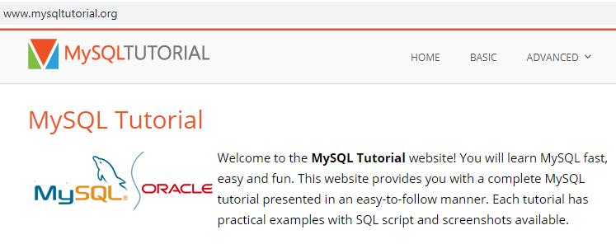
Practice Resources
References (mysqltutorial.org)
Data types primer
Aggregation primer
Subquery primer
Practice:
SQLZOO
CodeWars
(SQLite 3.2.8, PostgresSQL 9.6)
HackerRank
(DB2, MySQL, Oracle, MS SQL Server)
Data.world
Google BigQuery

Slide 18
SQL Coding Standards
SQL coding “best practices”
Capitalize all SQL Clauses & Keywords, Table Constraints and Functions
Lowercase for all fields & table names
Use “_” when defining multi-part column and table names
Keywords used as field names are encased in bracket ([]) characters
SQL Clauses on Separate Lines
SQL Coding Standards vary across entities/organizations.
However, the following SQL coding “best practices” are utilized in this class.
For a full list of “best practices” see the following resource: SQL Style Guide
Notes:
Example Query, Using Standards:
SELECT CASE postcode WHEN 'BN1' THEN 'Brighton' WHEN 'EH1' THEN 'Edinburgh' END AS city
FROM office_locations
WHERE country = 'United Kingdom’
AND opening_time BETWEEN 8 AND 9
AND postcode IN ('EH1', 'BN1', 'NN1', 'KW1');

Slide 19


